Slide 1



MongoDB VS SQL
Mootez Rhouma
DataBase Checkpoint
GOMYCODE - SOUSSE

Slide 2

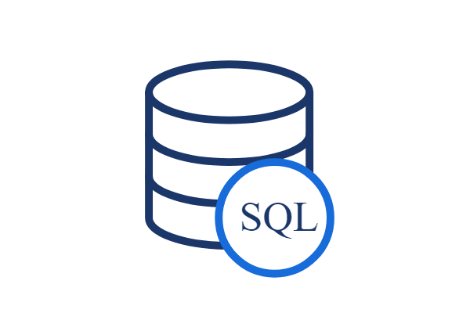
Introduction to SQL
For the deployment of Cloud applications, SQL Databases are typically used as Relational Databases. In addition to high-performance analytics, they provide various features for accessing, adding, managing, and processing data. It is a Database System that is easy to use, contains robust classification features, and offers uncomplicated reliability.

Slide 3

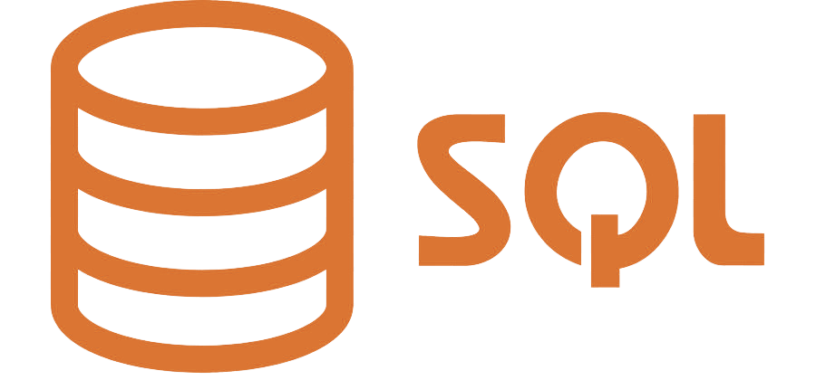

What Can SQL do?
SQL can execute queries against a database
SQL can retrieve data from a database
SQL can insert records in a database
SQL can update records in a database
SQL can delete records from a database
SQL can create new databases
SQL can create new tables in a database
SQL can create stored procedures in a database
SQL can create views in a database
SQL can set permissions on tables, procedures, and views

Slide 4



Introduction to MongoDB
It's an open-source, NoSQL document database. It is popularly used in conjunction with Amazon Web Services, Azure, and other data sources for application development and ongoing operation. In simple terms, MongoDB is a document-oriented database. This open-source product is developed and supported by 10gen.

Slide 5

Advantages of MongoDB
MongoDB offers many advantages over traditional relational databases:
Full cloud-based developer data platform
Flexible document schemas
Widely supported and code-native data access
Change-friendly design
Powerful querying and analytics
Easy horizontal scale-out with sharding
Simple installation
Cost-effective
Full technical support and documentation

Slide 6


What is better MongoDB or SQL?
Why MongoDB is better than SQL? In comparison to the SQL server, MongoDB is faster and more scalable. While the SQL server supports JOIN and Global transactions, MongoDB does not. The MS SQL server does not accommodate large amounts of data, however MongoDB does

